Slide 1
Using Arrays in C
We first show how to declare and define arrays. Then we present several typical applications using arrays including reading values into arrays, accessing and exchanging elements in arrays, and printing arrays.
Topics discussed in this section:
Declaration and Definition
Accessing Elements in Arrays
Storing Values in Arrays
Index Range Checking

Slide 2
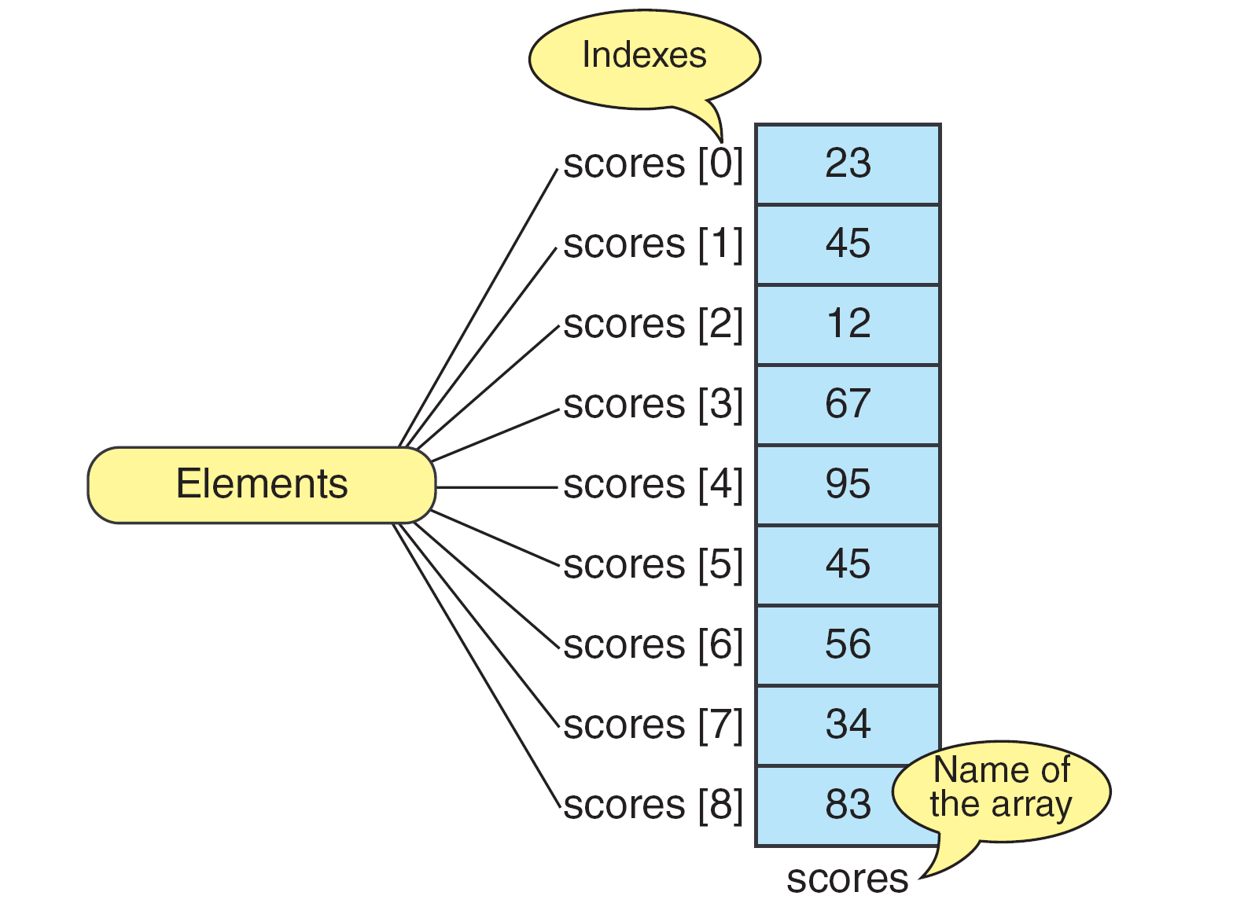
The Scores Array

Slide 3
Declaring and Defining Arrays

Slide 4
Note
Only fixed-length arrays can be initialized when they are defined. Variable length arrays must be initialized by inputting or assigning the values.

Slide 5
Initializing Arrays

Slide 6
Note
One array cannot be copied to another using assignment.

Slide 7
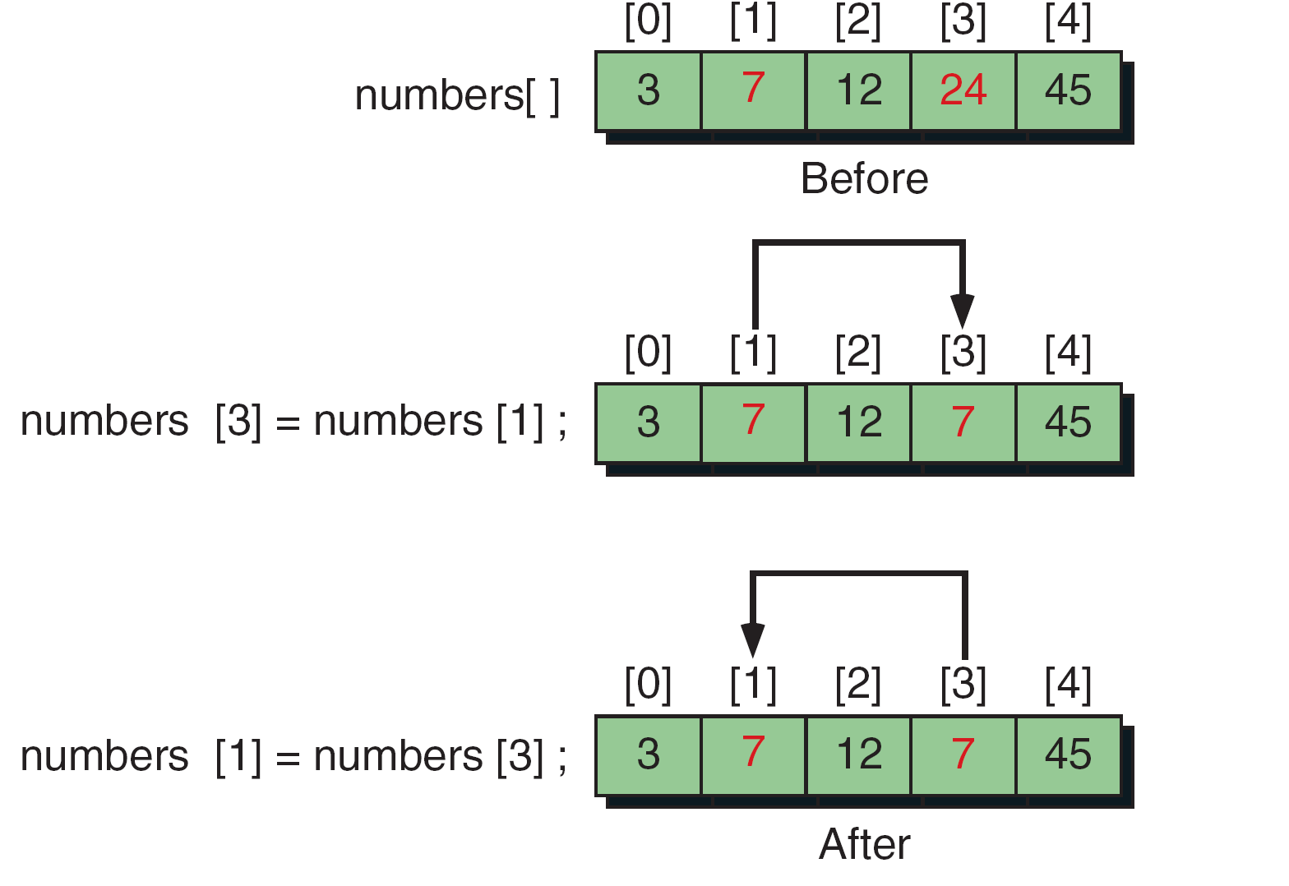
Swapping Scores—the Wrong Way

Slide 8
Swapping Scores with Temporary Variable

Slide 9
Squares Array

Slide 10
Squares Array

Slide 11
Passing Arrays
To process arrays in a large program, we have to be able to pass them to functions. We can pass arrays in two ways: pass individual elements or pass the whole array. In this section we discuss first how to pass individual elements and then how to pass the whole array.
Topics discussed in this section:
Passing Individual Elements
Passing the Whole Array

Slide 12
Passing Array Elements

Slide 13
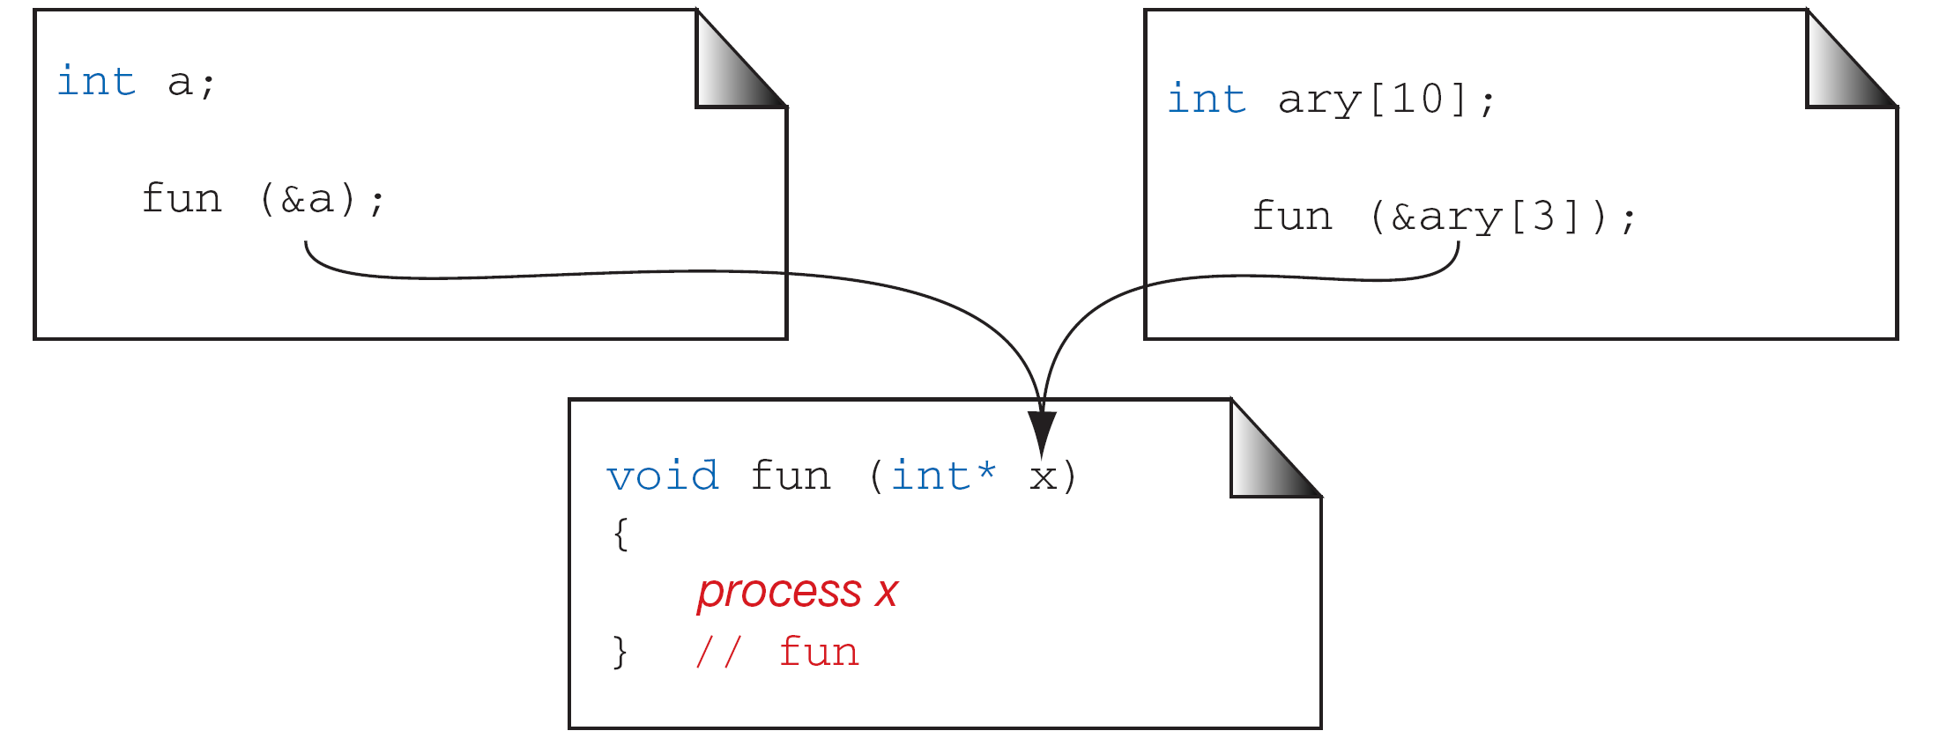
Passing the Address of an Array Element

Slide 14
{ // main
int arr[10];
int x;
func(arr);
}
void func( int farr[] ) {
farr[0] = 1;
}
Passing an array

Slide 15
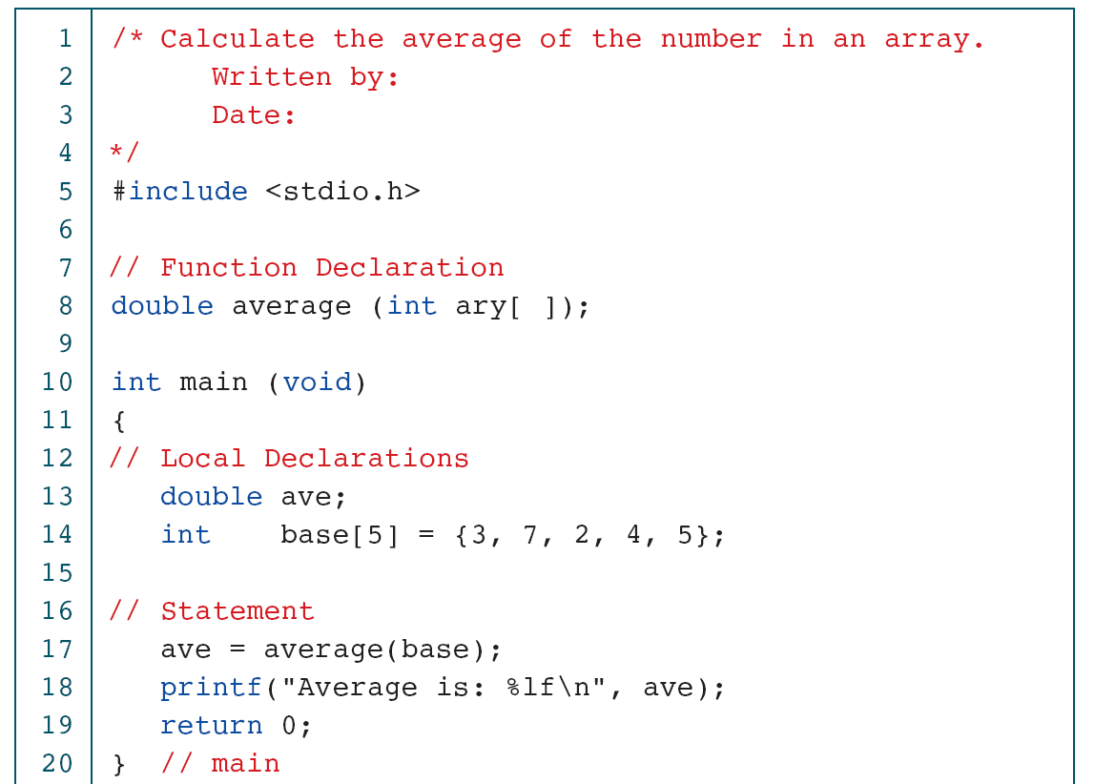
Calculate Array Average

Slide 16
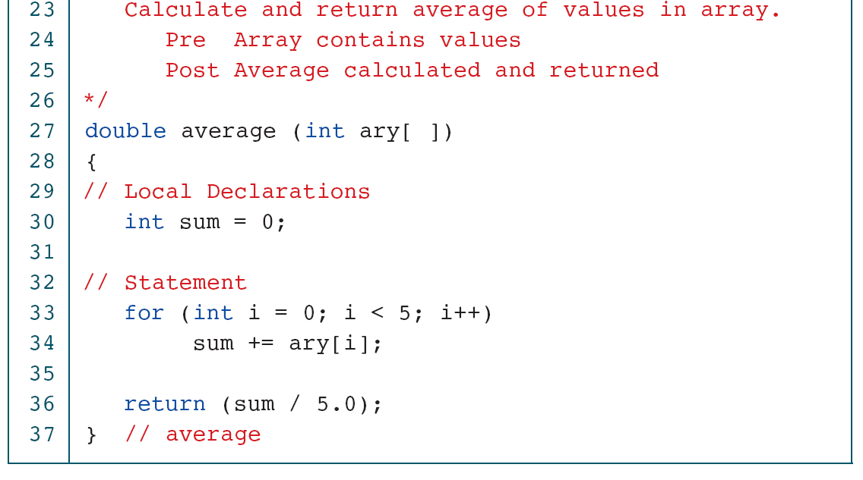
Calculate Array Average

Slide 17
Average Elements in Variable-length Array
Notes:
Don’t need *

Slide 18
Average Elements in Variable-length Array

Slide 19
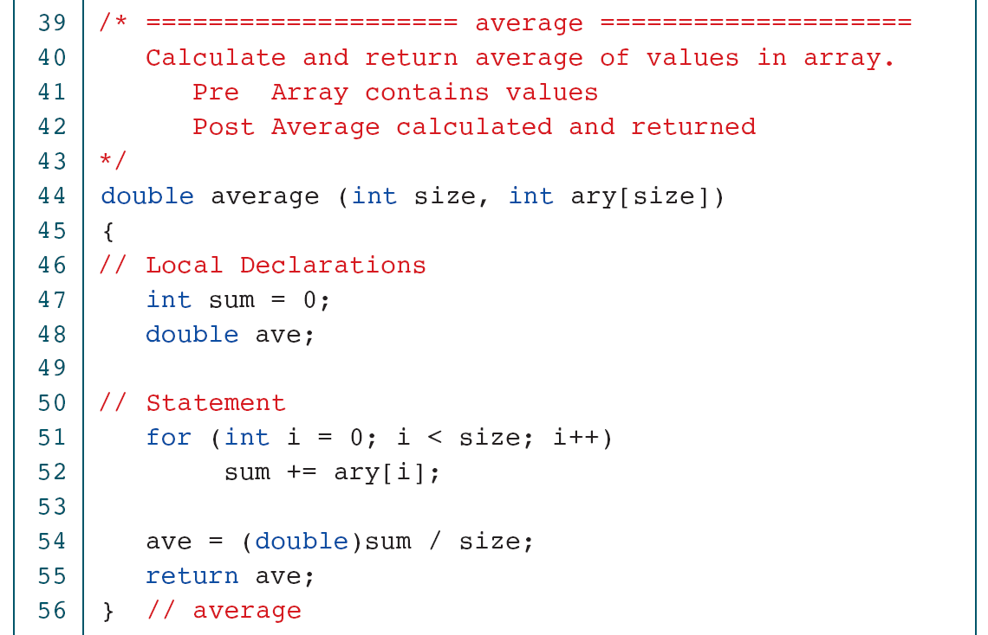
Average Elements in Variable-length Array
Notes:
Don’t’ need size in parameter

Slide 20
Average Elements in Variable-length Array

Slide 21
Change Values in an Array

Slide 22
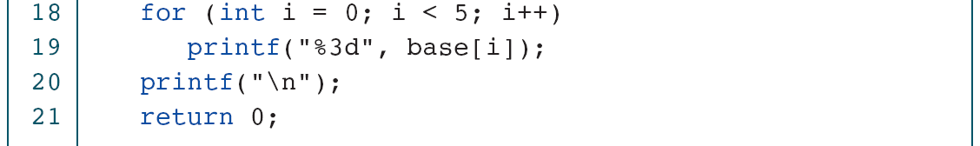
Change Values in an Array

